Slide 1

Focus on Teaching and Learning Opening Session
Innovative and Experiential Pedagogy in Classical Studies

Slide 2
Case Study: Reacting to the Past
Role-playing game utilized in an introductory History course at previous institution (Democracy and Difference: The Ancient Athenian Experiment)
Games available for all sorts of time periods and issues (https://reacting.barnard.edu/games)
Hones public speaking, application of sources, teamwork, writing, negotiation skills
Games deal with societal issues such as voting rights, payment for public service, religious controversies etc
Used very successfully online using Zoom and Slack
Concluded with reflective portfolio

Slide 3
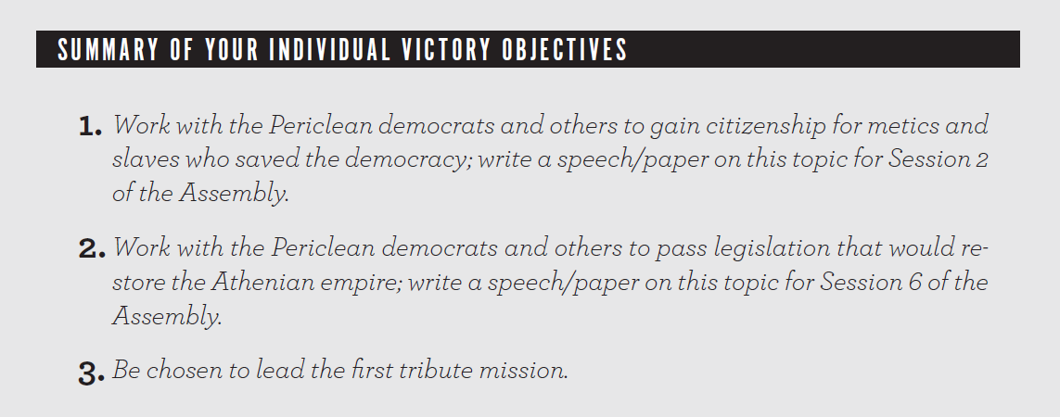

Slide 4

Each student received a Zoom background customized to their faction/role

Slide 5
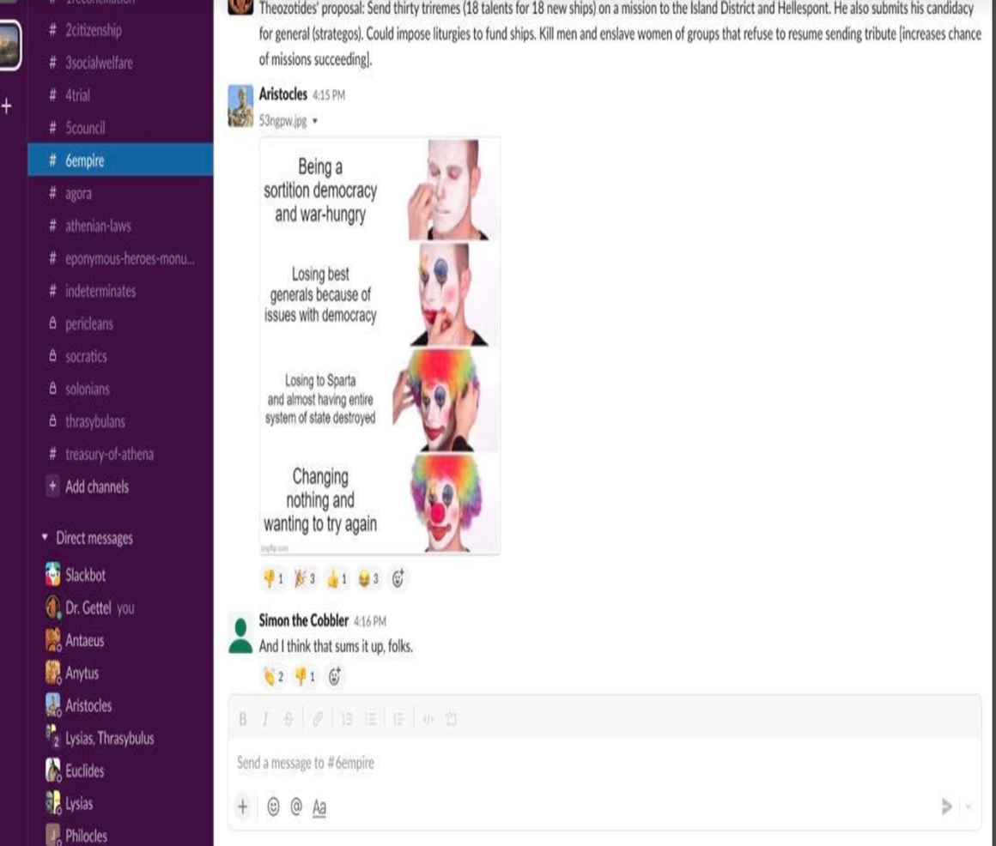
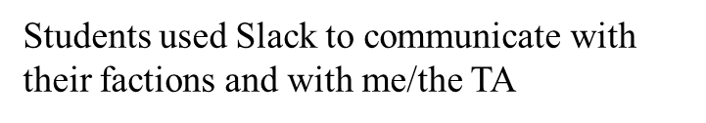


Slide 7
